Slide 1
EE329 Analog CAN Board
Wyatt Tack

Slide 2
MCU Choice
STM32G484RE
Chosen for Faster clock and fast math for good ADC sampling, CAN transfer, and DSP.

Slide 3
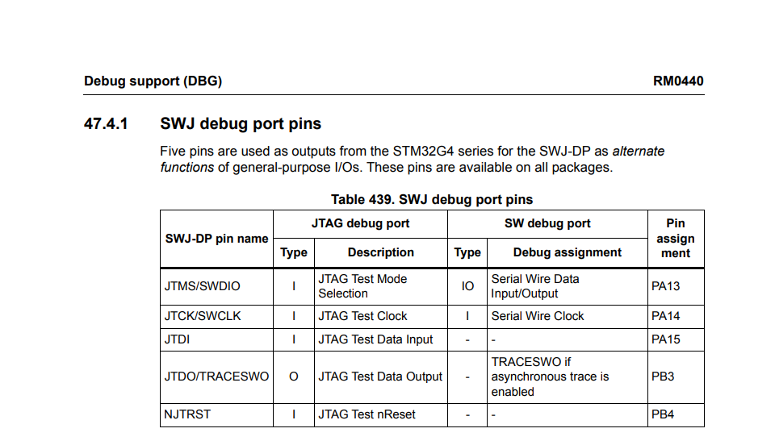
Programming
Will be using JTAG

